Slide 1

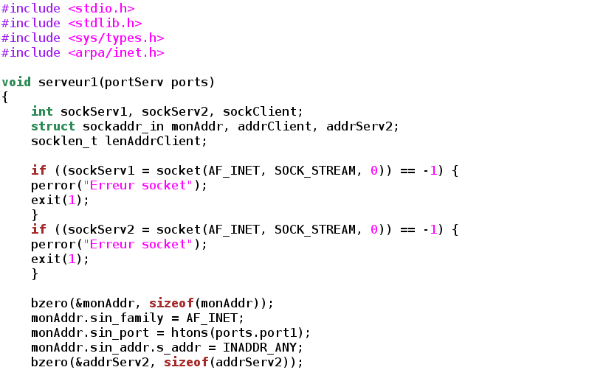


Introduction to C programming
Vistas in Advanced Computing Program
Martín Huarte-Espinosa
mhuartee@central.uh.edu
cacdsatuh
@UHCACDS
www.cacds.uh.edu

Slide 2
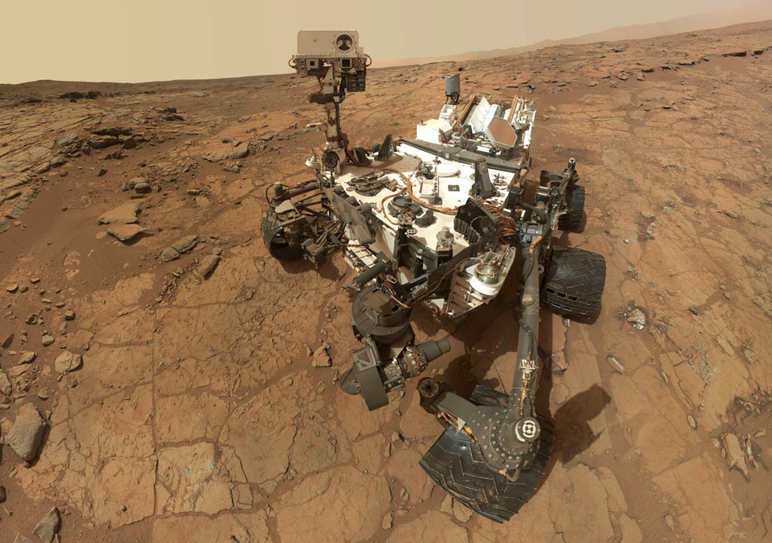
Why C?
500,000 lines of C code are powering NASA’s Mars Curiosity Rover
Notes:
Also used for kernel development

Slide 3
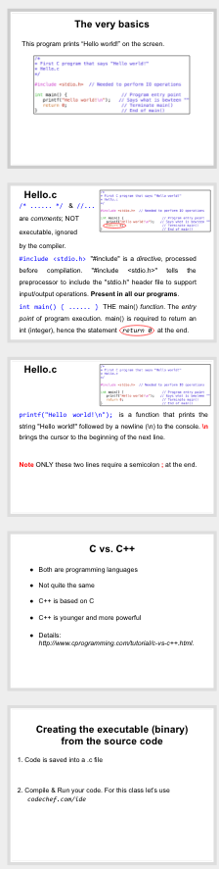
Overview
The main function and the very basics
Declaring variables & reading from keyboard
Arithmetics, Math and simple arrays
Loops, IFs and condition/logical operators
References.

Slide 4
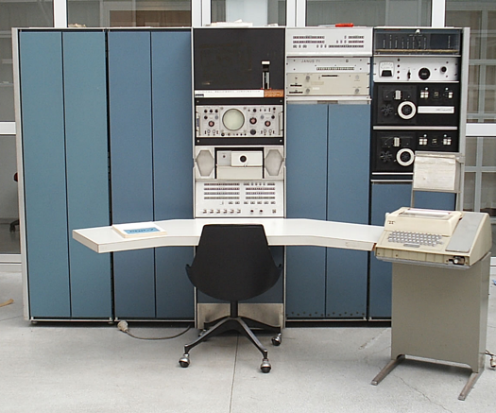
C - Historical highlights
C stems from the language BCPL, developed by Martin Richards. Indirect influence through the language B by Ken Thompson in 1970 at Bell Labs, for the first UNIX system on a DEC PDP-7 (photo).
In 1972 Dennis Ritchie at Bell Labs writes C and in 1978 the publication of The C Programming Language by Kernighan & Ritchie revolutionized the computing world.
wikipedia
Standardized by the American National Standards Institute since 1989 and subsequently by the International Organization for Standardization.
One of the most widely used programming languages
Various C compilers available for the majority of computer architectures and operating systems.
Many younger languages have borrowed directly or indirectly from C, including C++, Java, and Python.

Slide 5
C vs. C++
Both are programming languages
Not quite the same
C++ is based on C
C++ is younger and more powerful
Details: http://www.cprogramming.com/tutorial/c-vs-c++.html.

Slide 6
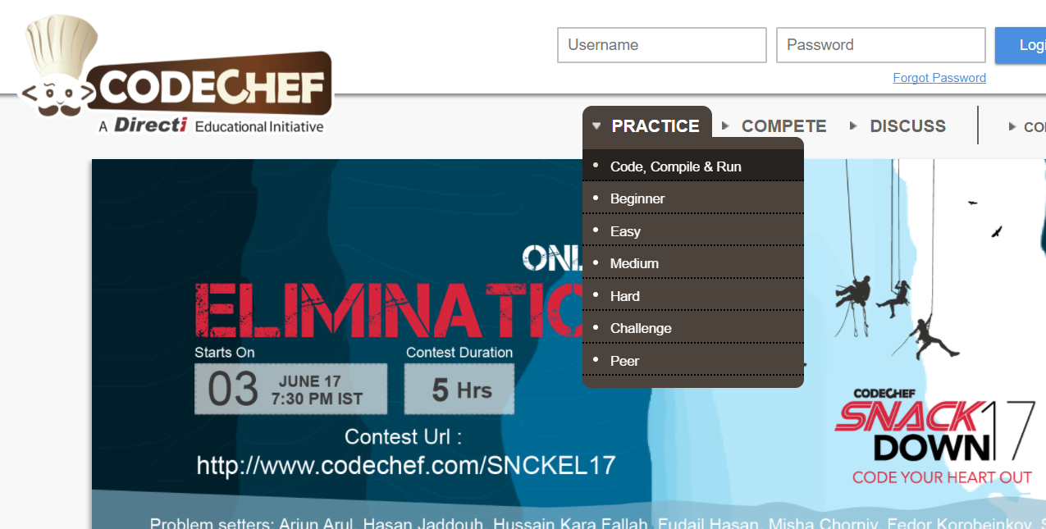
We use the website Codechef.com to write our code; compile and run them. Steps to open :
Go to https://www.codechef.com/ on your browser
Under “Practice” goto Code,Compile & Run

Slide 7
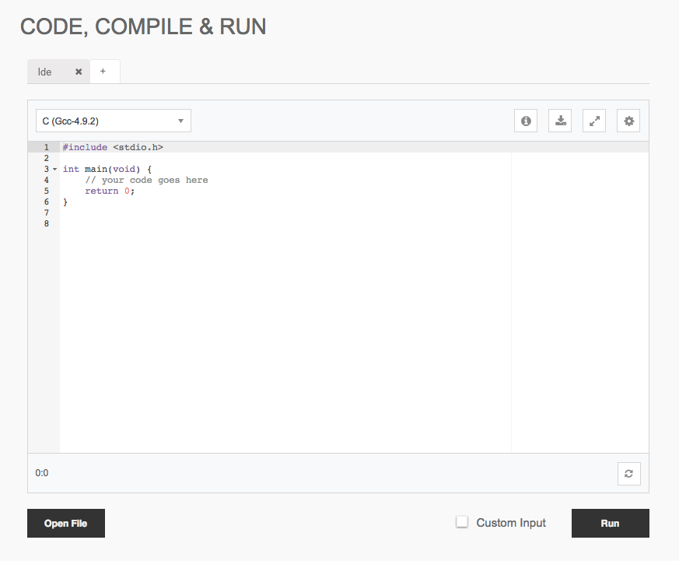
3.Change the programming language to C from the dropdown

Slide 8
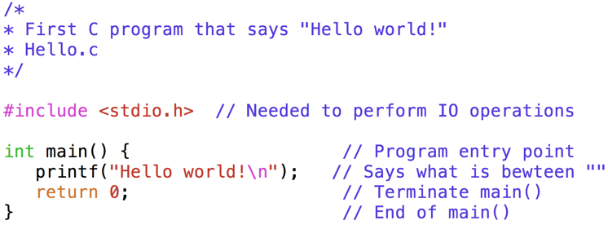
The very basics
Use a text editor to open the code file Hello.c.
This program prints “Hello world!” on the screen.

Slide 9
Hello.c
/* ...... */ & //...
are comments; NOT
executable, ignored
by the compiler.

Slide 10
Hello.c
/* ...... */ & //...
are comments; NOT
executable, ignored
by the compiler.
#include <stdio.h> "#include" is a directive, processed before compilation. "#include <stdio.h>" tells the preprocessor to include the "stdio.h" header file to support input/output operations. Present in all our programs.

Slide 11
Hello.c
/* ...... */ & //...
are comments; NOT
executable, ignored
by the compiler.
#include <stdio.h> "#include" is a directive, processed before compilation. "#include <stdio.h>" tells the preprocessor to include the "stdio.h" header file to support input/output operations. Present in all our programs.
int main() { ...... } THE main() function. The entry point of program execution. main() is required to return an int (integer), hence the statement return 0 at the end.

Slide 12
Hello.c
printf("Hello world!\n"); is a function that prints the string "Hello world!" followed by a newline (\n) to the console. \n brings the cursor to the beginning of the next line.

Slide 13
Hello.c
printf("Hello world!\n"); is a function that prints the string "Hello world!" followed by a newline (\n) to the console. \n brings the cursor to the beginning of the next line.
return 0; Terminates the main() function and returns a value of 0 to the operating system. NEEDED.

Slide 14
Hello.c
printf("Hello world!\n"); is a function that prints the string "Hello world!" followed by a newline (\n) to the console. \n brings the cursor to the beginning of the next line.
return 0; Terminates the main() function and returns a value of 0 to the operating system. NEEDED.
Note ONLY these two lines require a semicolon ; at the end.

Slide 15
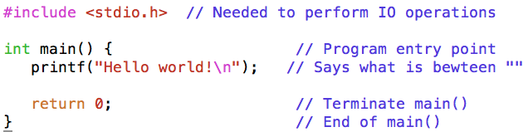
Let’s add a few more lines to Hello.c.
Add this below int main() {
int integer1;
Add these below printf...;
printf("Enter integer: ");
scanf("%d", &integer1);
printf("%d + 1 = %d \n", integer1, integer1+1);

Slide 16
int integer1;
printf("Enter integer: ");
1st part
scanf(“...” , ...);
2nd part
int used to DECLARE an integer number.
integer1 is the variable name or IDENTIFIER.
printf() prompts a message.
{
{

Slide 17
int integer1;
printf("Enter integer: ");
scanf("%d", &integer1);
scanf() reads user input from keyboard and stores into Integer1.
%d will be substituted by integer1.
int used to DECLARE an integer number.
integer1 is the variable name or IDENTIFIER.
printf() prompts a message.
An ampersand &, before integer1 stands for address-of operator.
A missing “&” in scanf() is a common error, leads to abnormal program termination.
“Segmentation fault (core dumped)”.

Slide 18
printf("%d + 1 = %d \n", integer1, integer1+1);
1st argument always between “”
each %d will be substituted by integers after the “,
Text ( + 1 = ) is printed as is
\n brings the cursor (jumps) to the next line.
2nd argument always after (“...”,
printf("%d + 1 = %d \n", integer1, integer1+1);

Slide 19
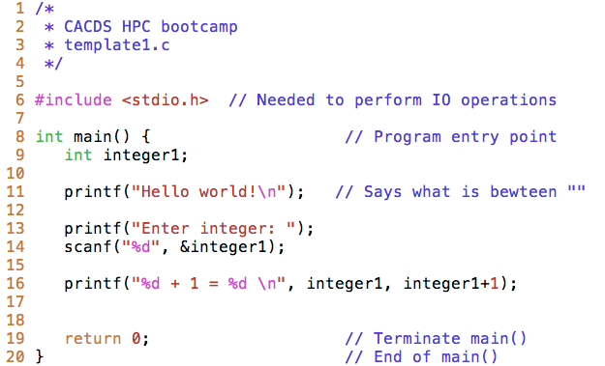
The program should look like this:
;
NOTE
All declaration and execution lines MUST end with ;

Slide 20
Exercise 1
The last program is saved in template2.c.
Add further lines to our program.
Add code so that:
- You keep the “Hello…” line but it’s not executed
- The program reads 2 integer numbers, instead of just one
- The program has an integer variable called sum which computes: integer1+integer2
- The program writes the integers and the sum result.
For example: If I enter 5 and 6, the program outputs:
“The sum of 5 and 6 is 11.”
Run.

Slide 21
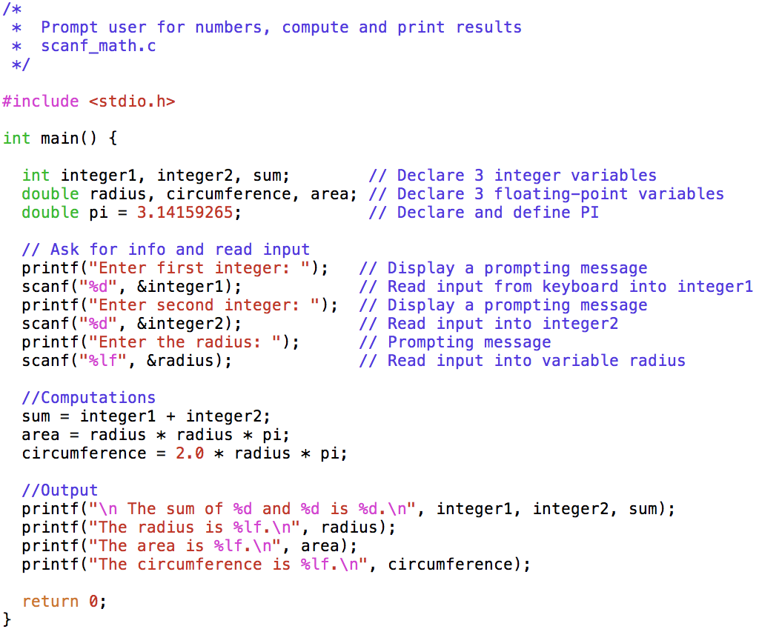
Let’s explore: read data from keyboard, do simple math, output results on screen.

Slide 22
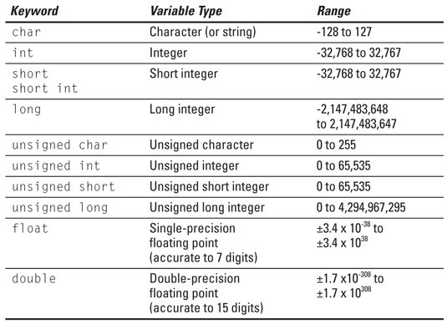
scanf_math.c

Slide 23
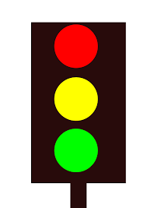
Variable names or identifiers
Allowed: 0, …, 9, a, …, z, A, …, Z, _
VARIABLE = variable; C is case sensitive.
No blanks or commas
First character cannot be a number
Reserved keywords (int, character, if, continue) not allowed
Name cannot be global identifier:
Valid: _NAME_ _SUM_
Invalid: _DATE_ _TIME_ _FILE_
Name cannot be the same as
another one within the scope of the
function:
Invalid:
/
#include<stdio.h> int main(){ int var1 = 1; int var1 = 2; printf("%d",var1); return 0; }

Slide 24
Back to scanf_math.c
scanf() reads keyboard input. Stores in radius.
A conversion specifier begins with %, followed by a data type code. %lf is for a double precision real number; stands for (l)ong (f)loat.
& before radius is for address-of operator. DON’T FORGET IT.

Slide 25
scanf_math.c
Basic arithmetics
<- VERY USEFUL
Operator | Meaning | Example
+ | Addition | x + y
- | Subtraction | x - y
* | Multiplication | x * y
/ | Division | x / y
% | Modulus (Remainder) | x % y
++ | Increment x by 1 | ++x or x++
-- | Decrement x by 1 | --x or x--

Slide 26
scanf_math.c
printf(“...”, ...);
1st argument always between “”. Consists of:
Text. Printed as is.
A conversion specifier begins with %, followed by a data type code. %d is for (d)ecimal integer.
\n brings the cursor (jumps) to the beginning of the next line.
2nd argument always after (“...”,.
first %d <- integer1
second %d <- integer2
third %d <- sum

Slide 27
scanf_math.c
printf();
%lf is for a double precision real number; stands for (l)ong (f)loat.
\n (again) brings the cursor to the beginning of next line.
2nd argument:
%lf <- radius

Slide 28
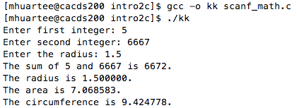
Let’s write this program into codechef. Then run.
Output:

Slide 29
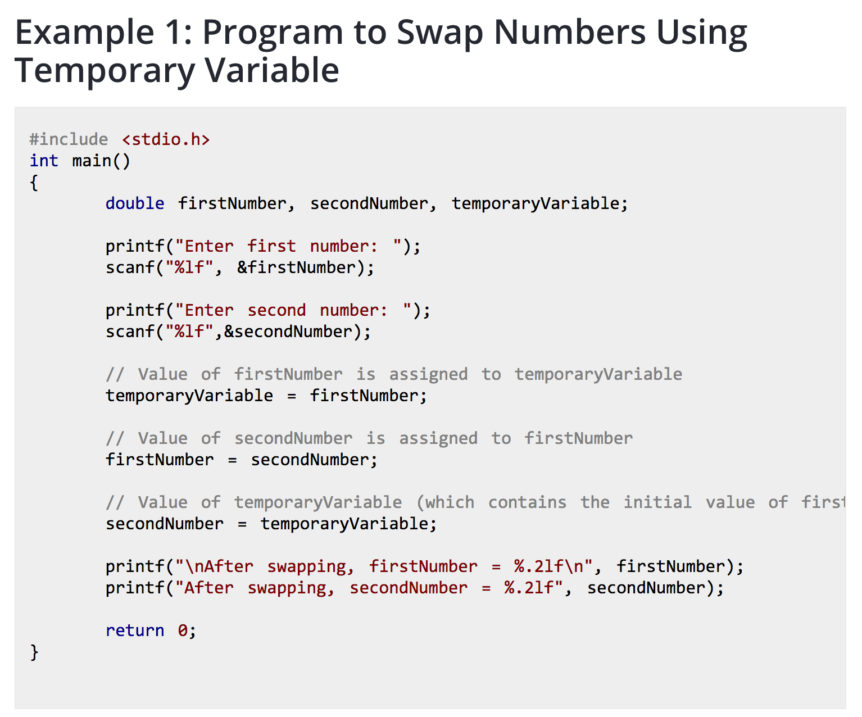
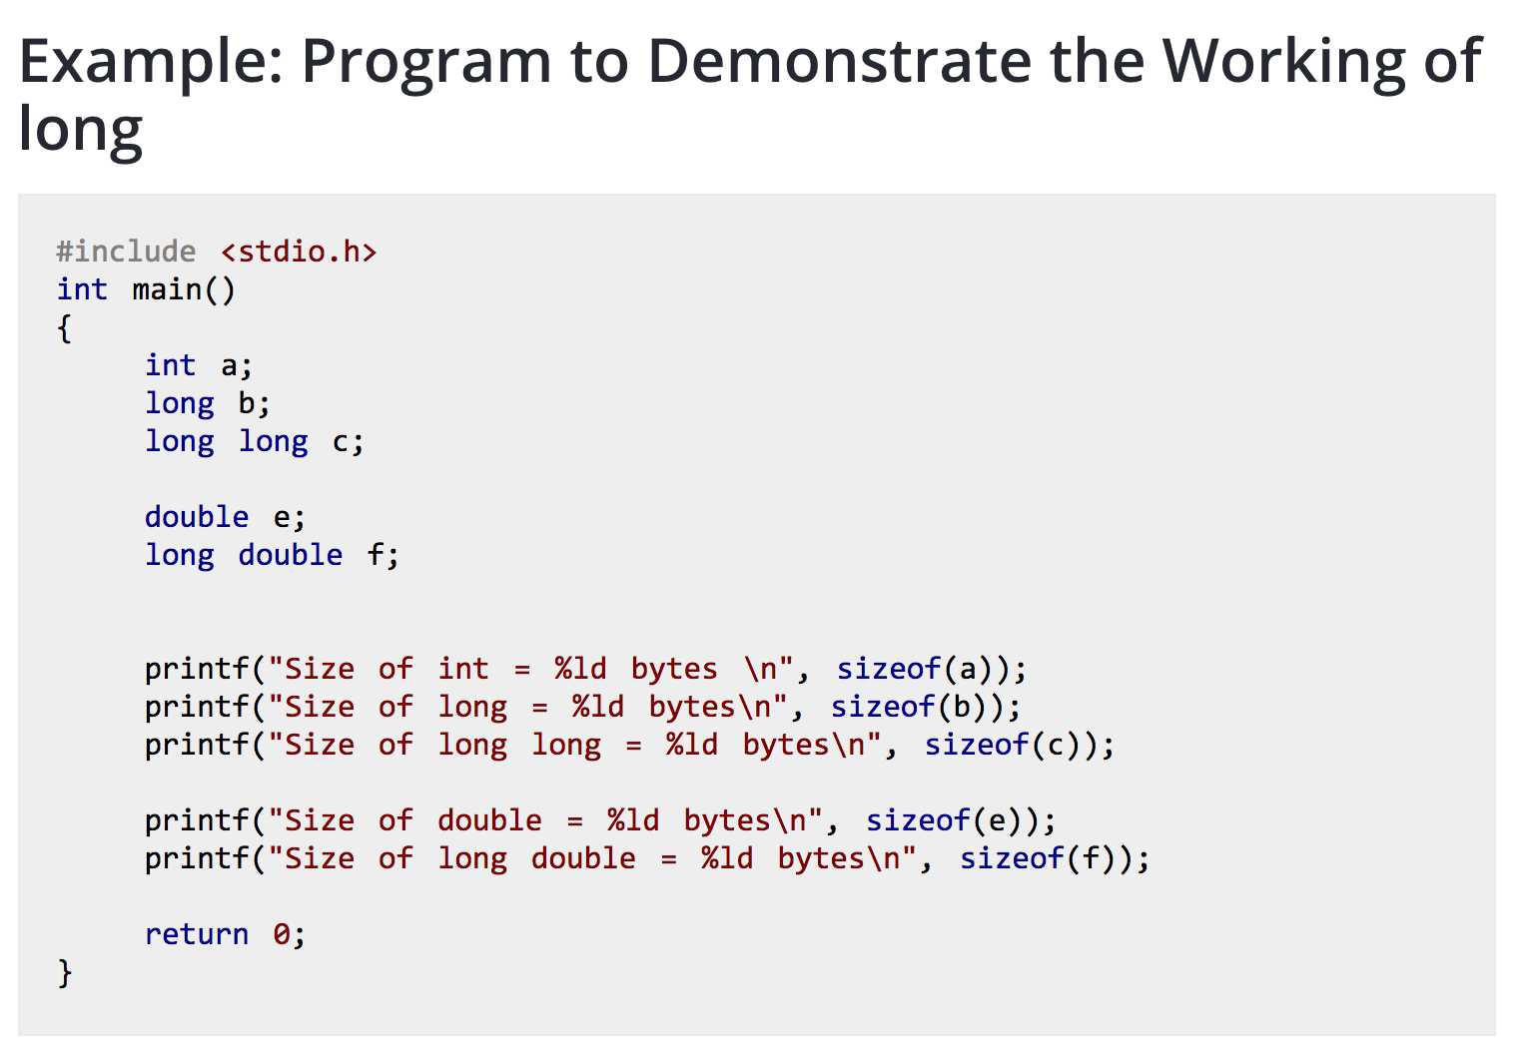
Day 1 VIDEOS
-c is awesome, https://youtu.be/smGalmxPVYc
-top 10 progr. Languages, https://youtu.be/MOz-fSDYlFc
-intro, hello world, https://youtu.be/CPjZKsUYSXg

Slide 30
